Slide 1

Learn Programming and Computational Thinking
Help setting up school libraries in India

Slide 2
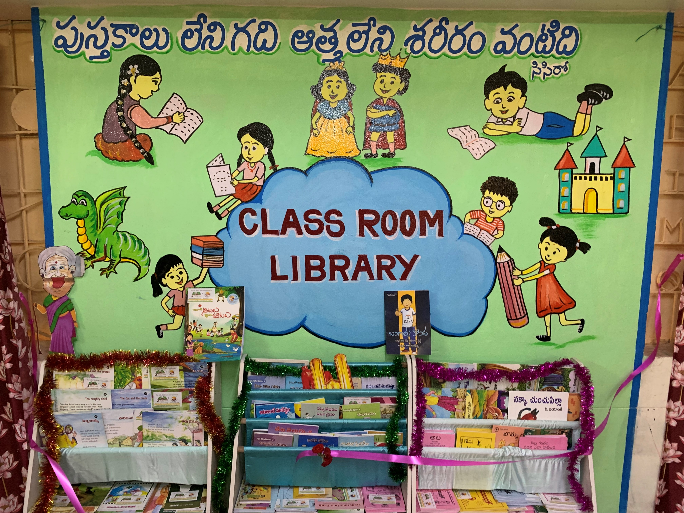
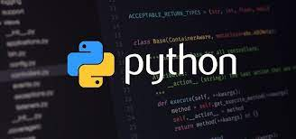
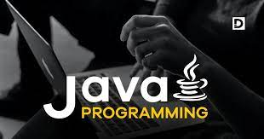
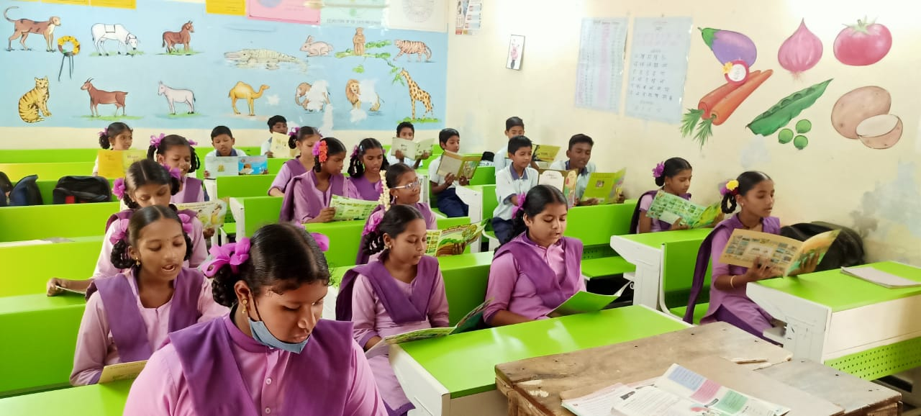
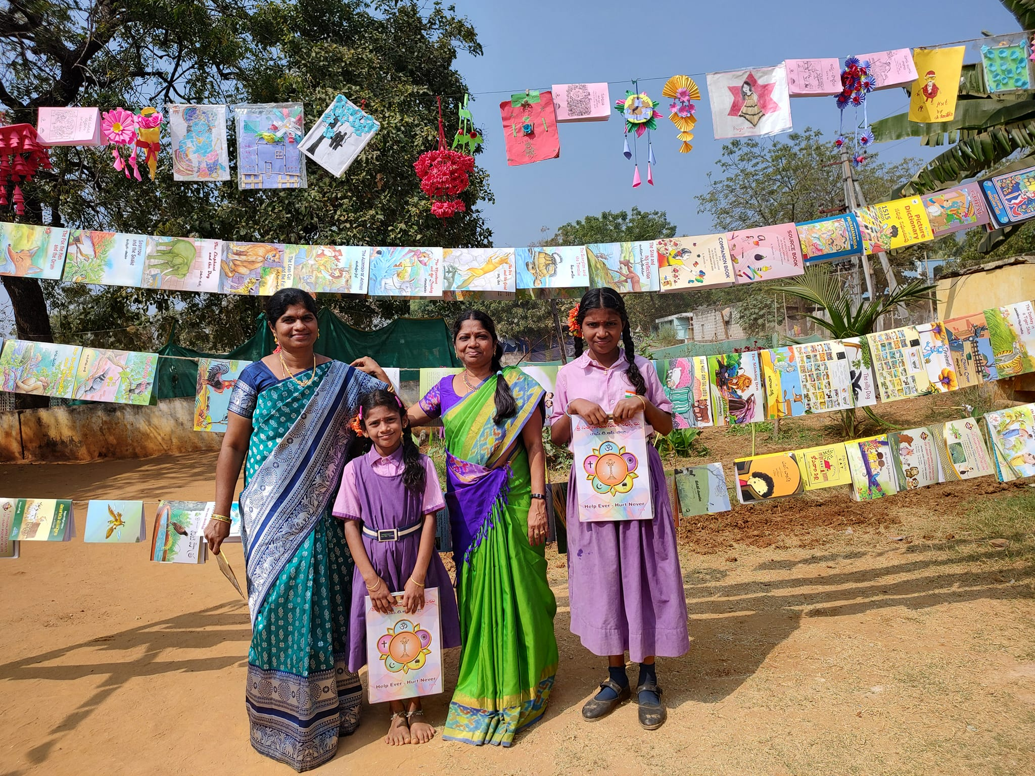
“Learn and Help” Concept:
Your child (or you) will learn CS programming and computational thinking
And you will set up a library (at a school of your choice) in AP or Telangana.

Slide 3

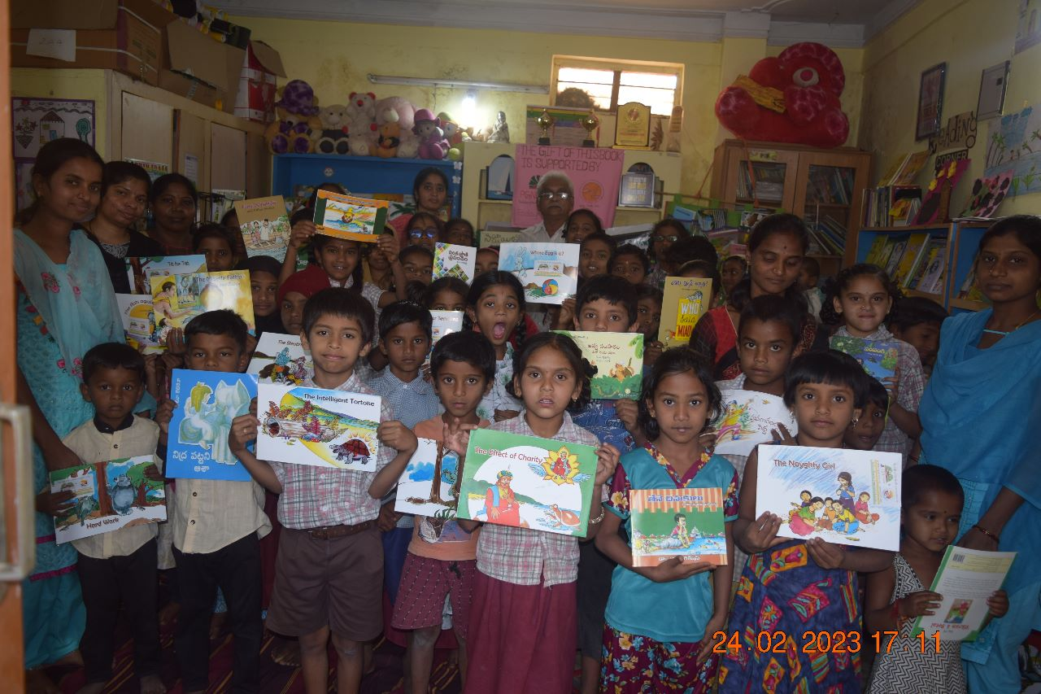


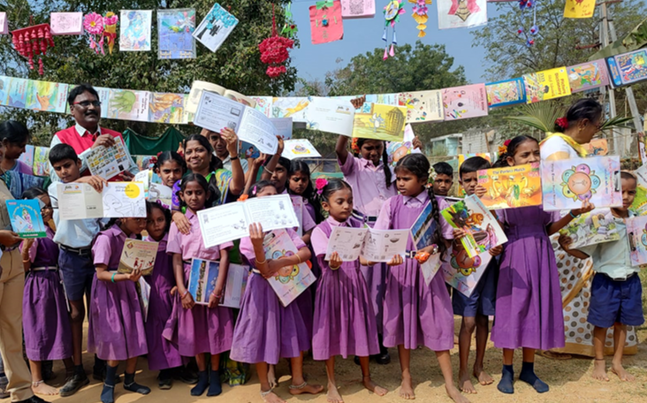
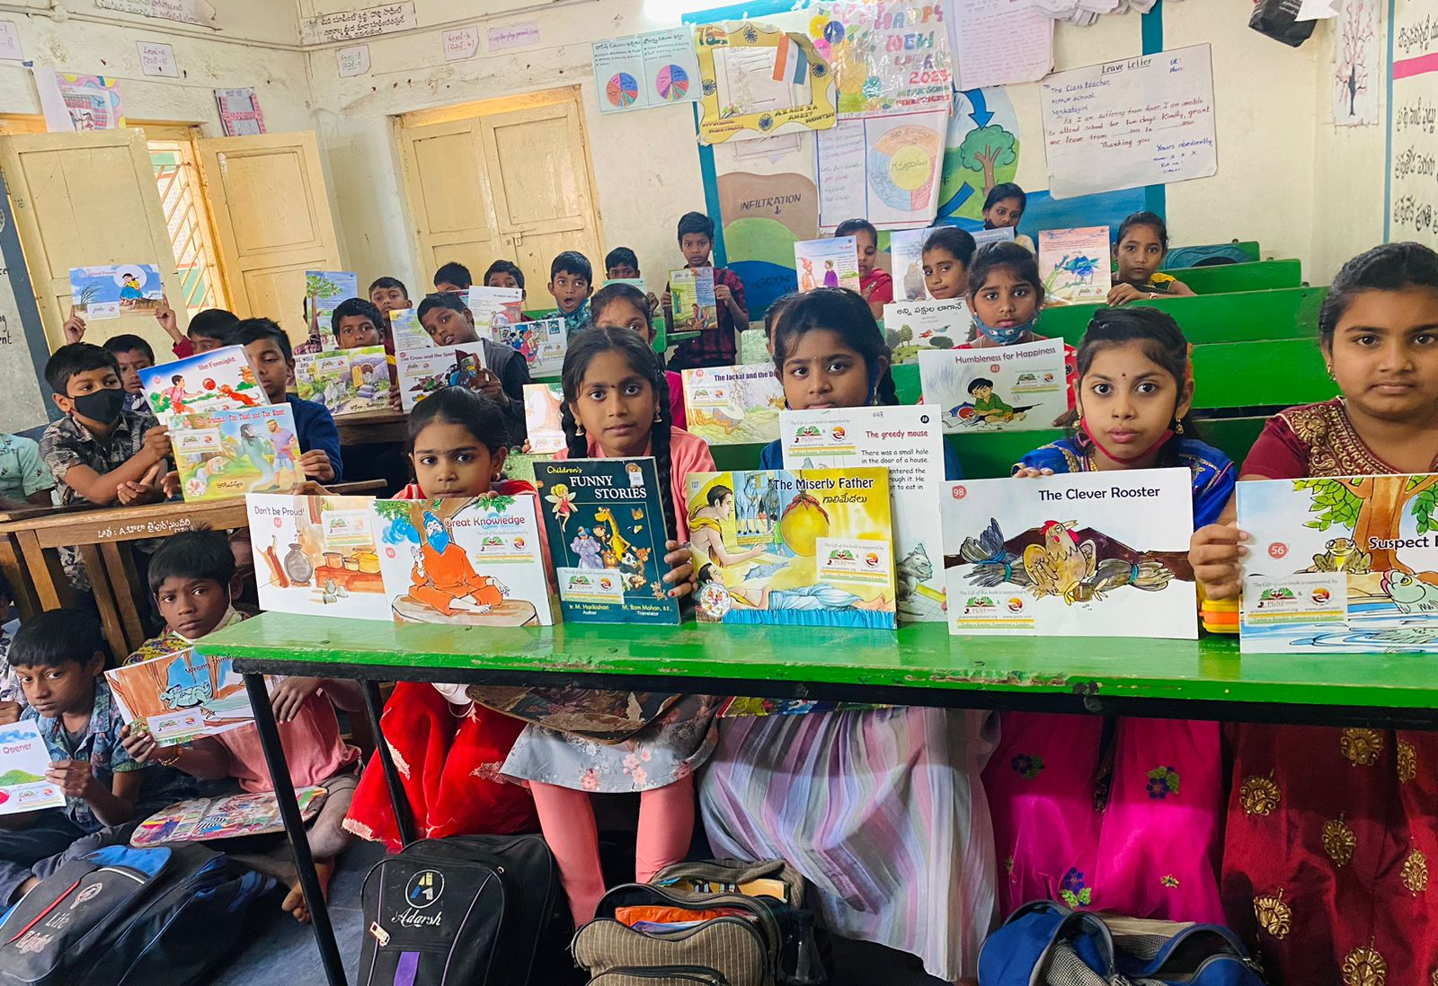
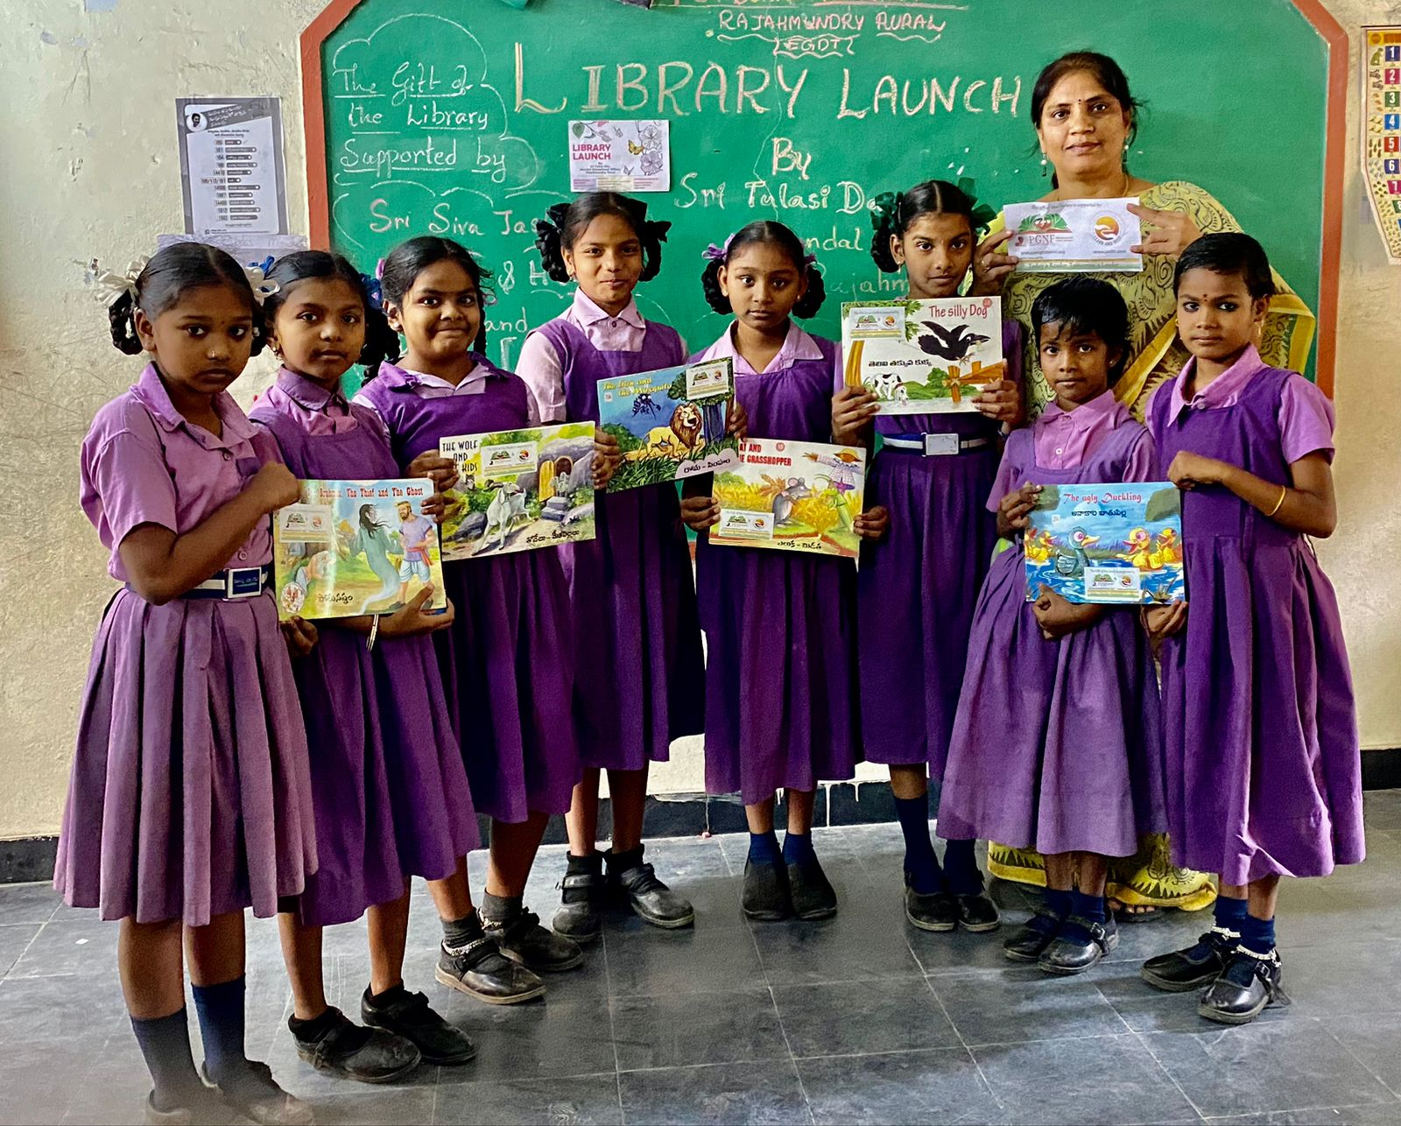
“Learn and Help” in 2022-23
Students (Class of 2023)
Set up 60 School Libraries in 2022-23

Slide 4

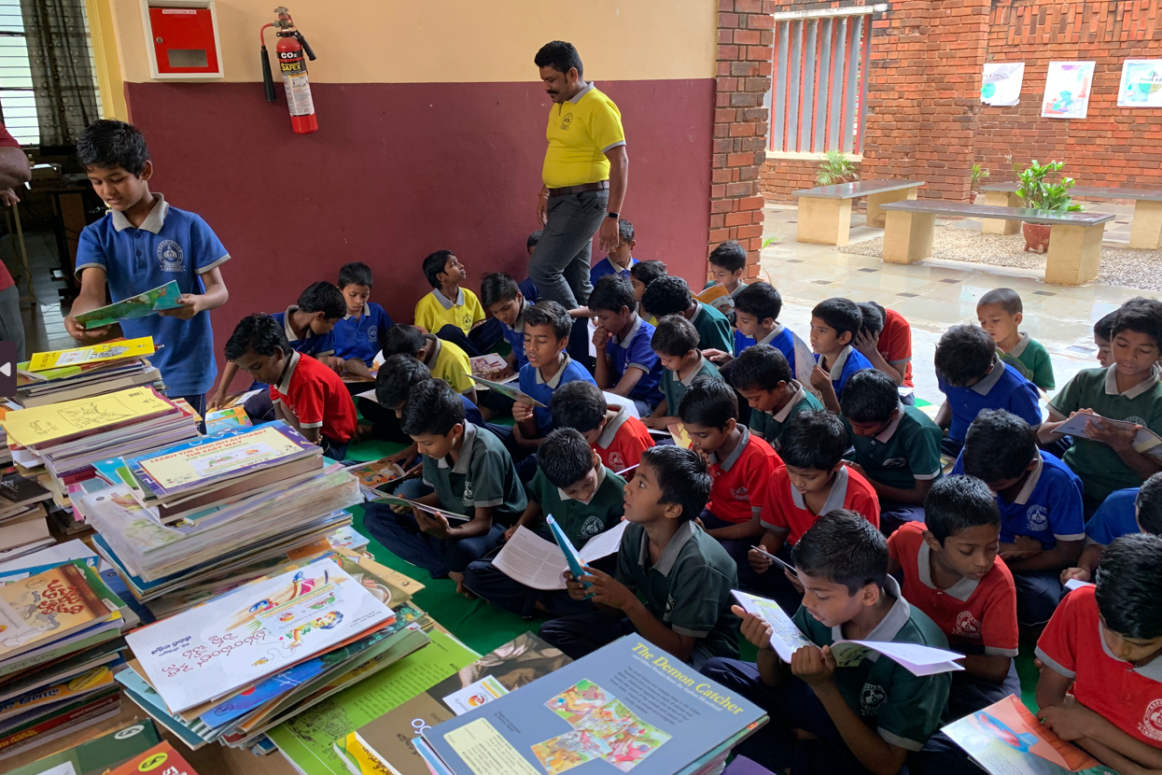
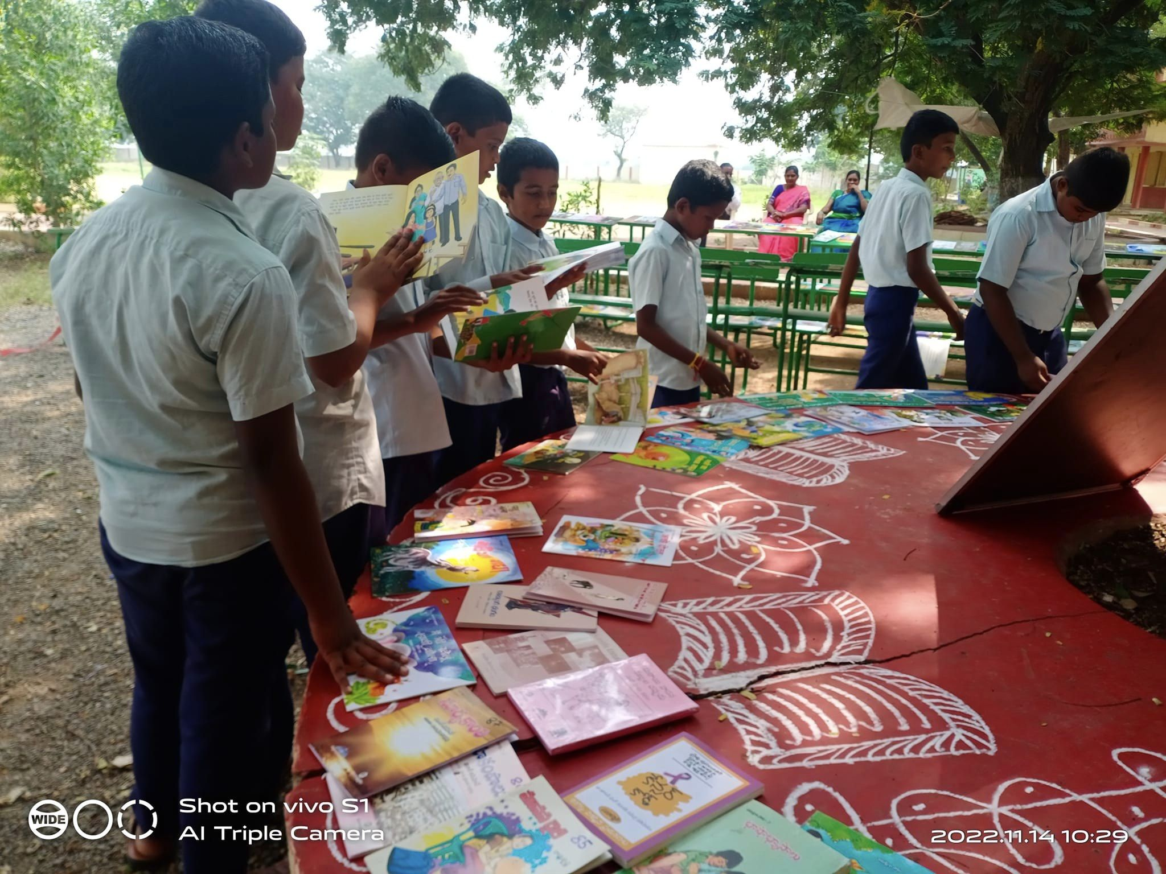
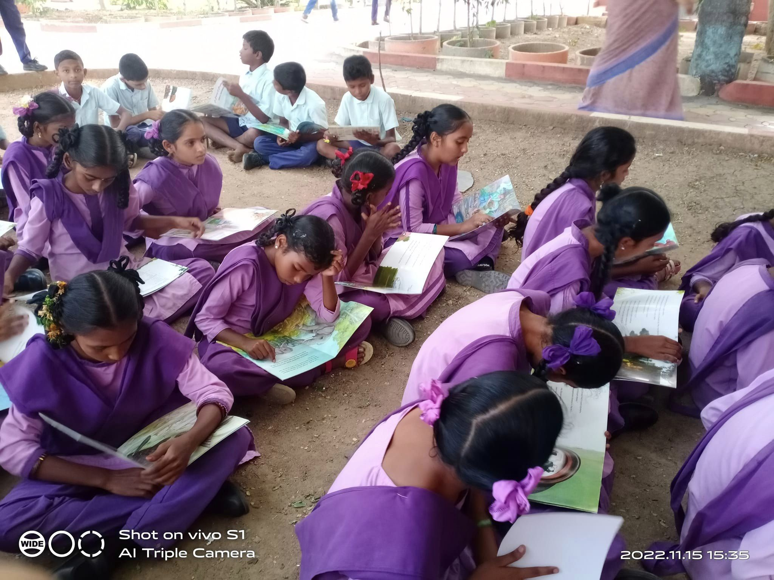
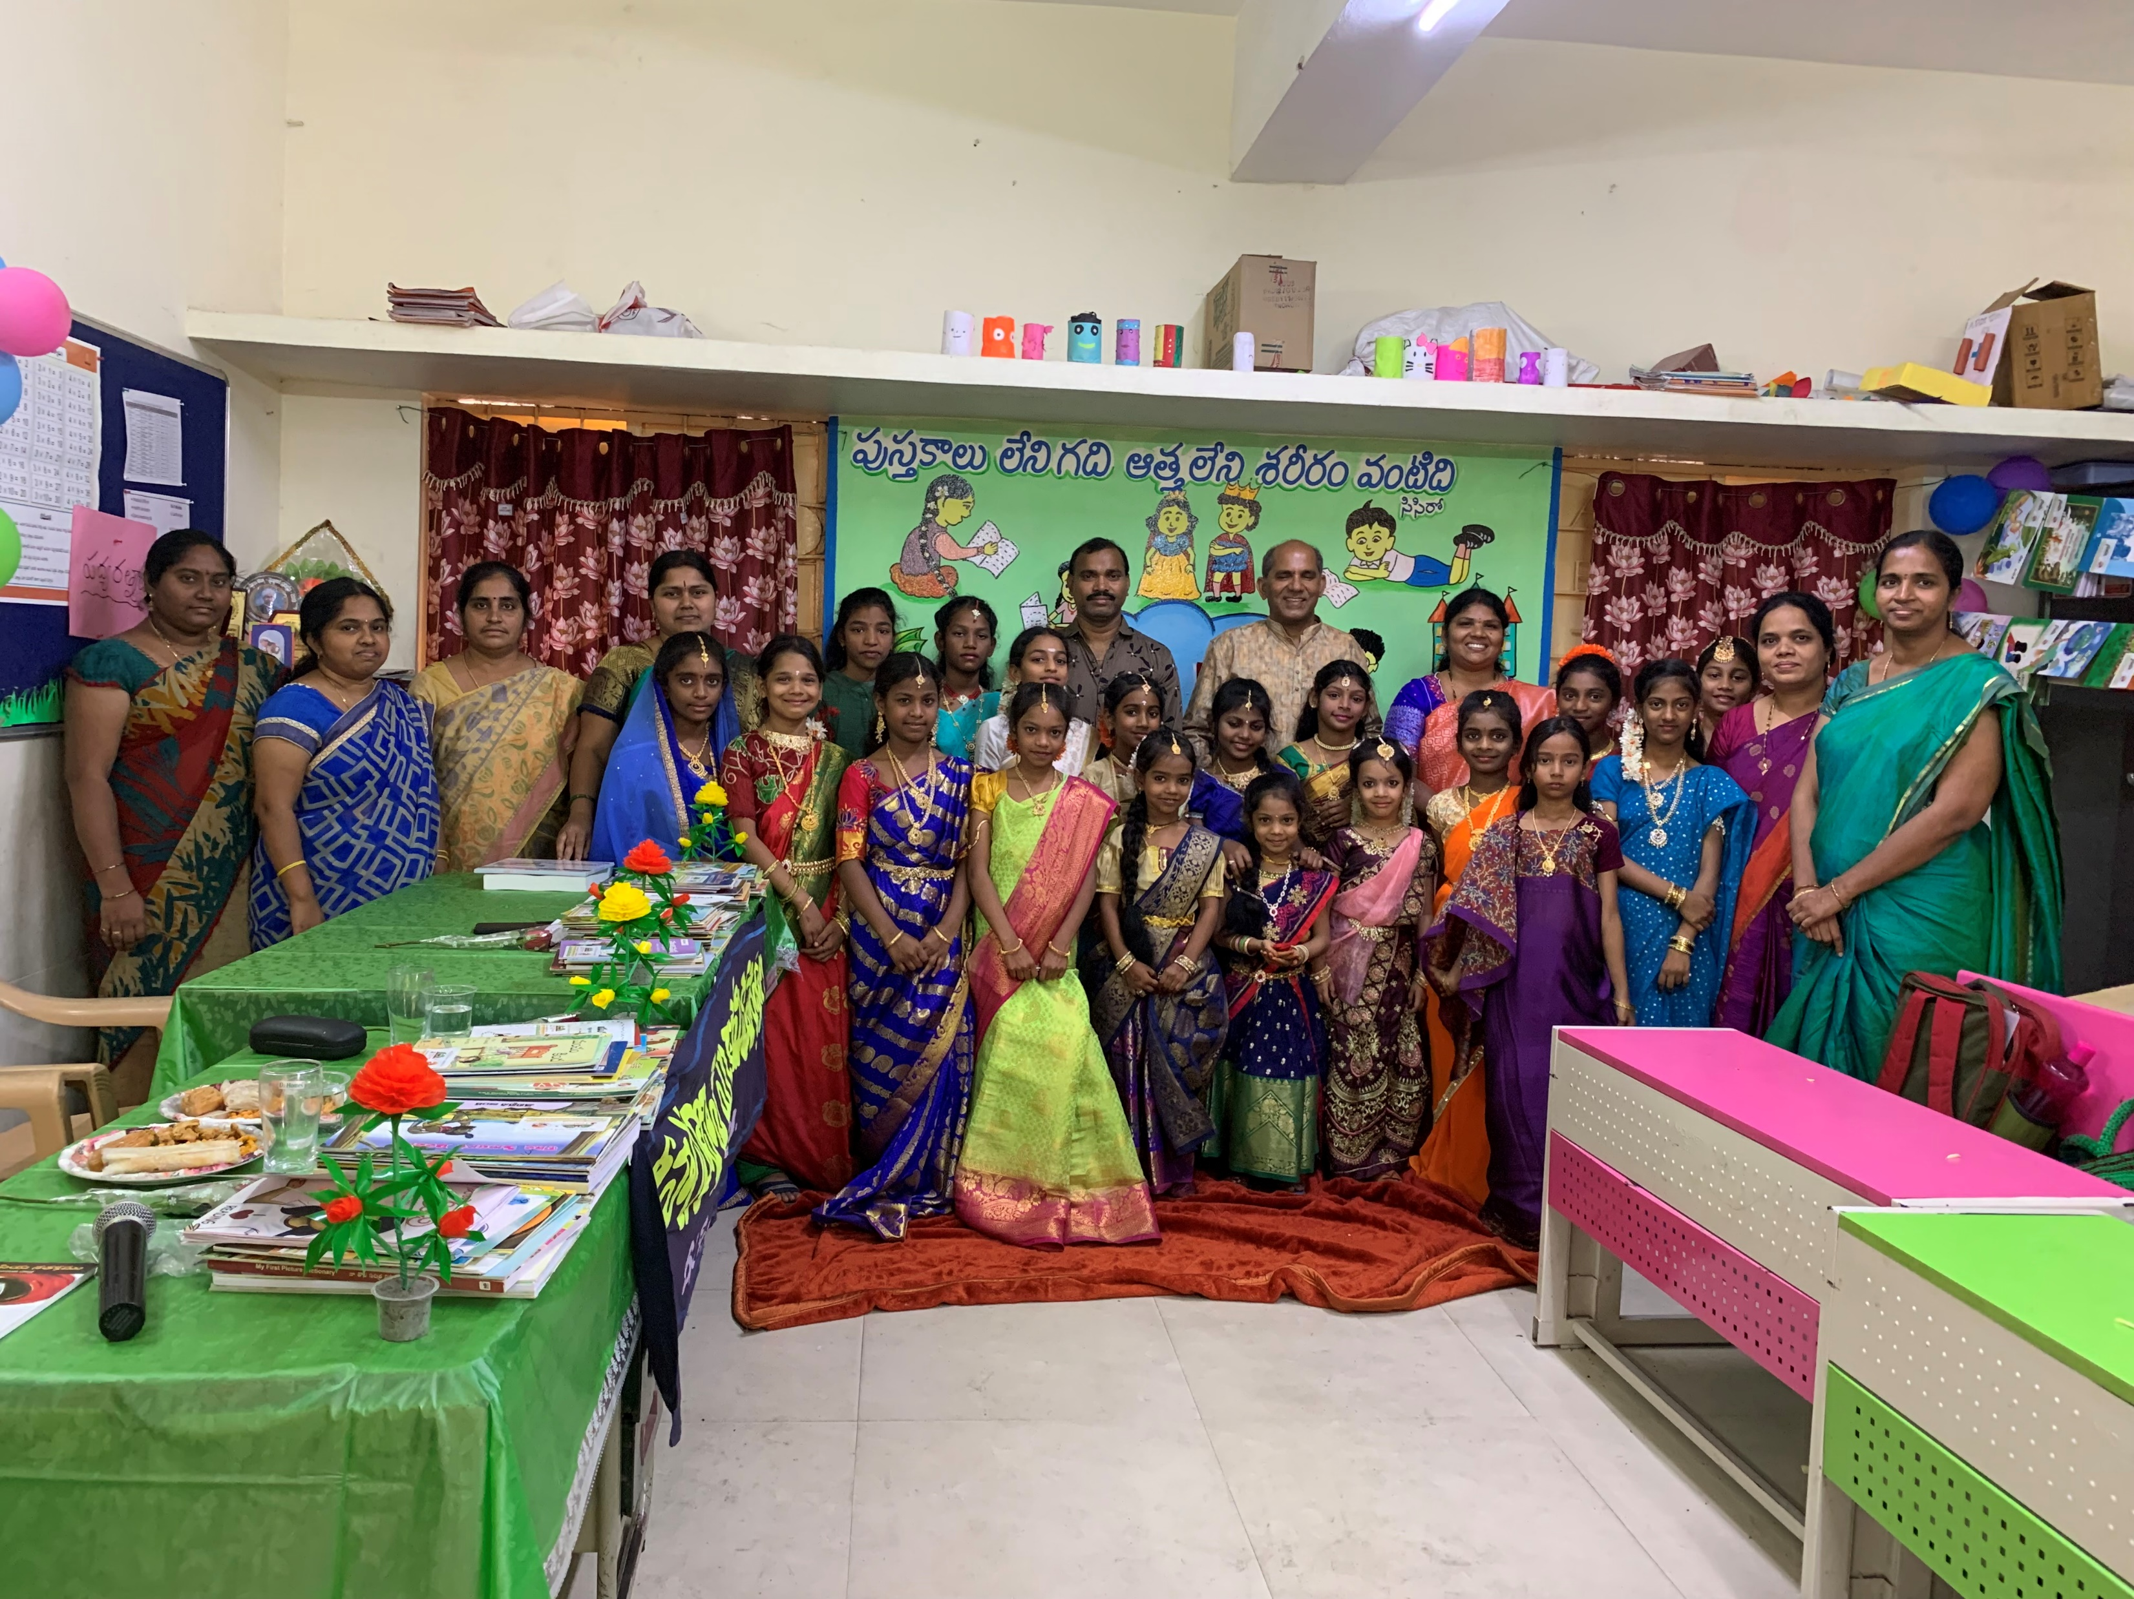
Any questions?
Please contact Siva Jasthi
Siva.Jasthi@gmail.com
651.276.4671

